Slide 1
Strings in Java
Instructor Khurram Iqbal

Slide 2
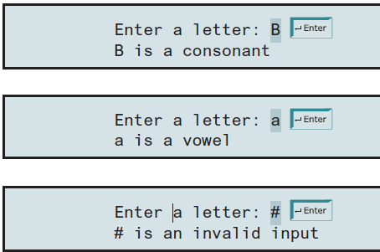
Exercise 1 – JAVA Strings & Methods
Write a program that prompts the user to enter a letter and check whether the letter is a vowel or consonant. For a nonletter input, display invalid input.

Slide 3
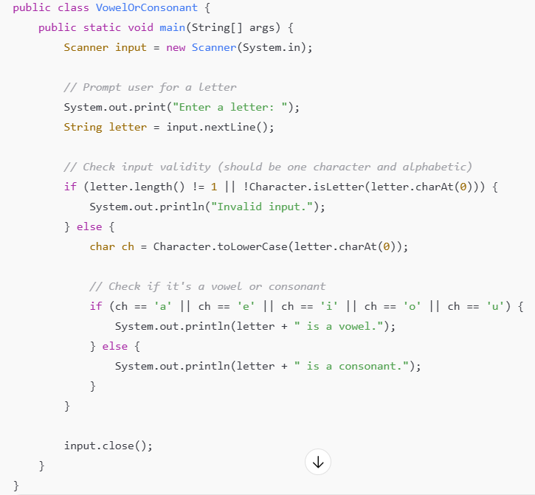

Slide 4
Exercise 2 –
Write a program that prompts the user to enter a letter grade A, B, C, D, or F and displays its corresponding numeric value 4, 3, 2, 1, or 0.
For other input, display invalid grade.

Slide 5
import java.util.Scanner; public class GradeToNumber { public static void main(String[] args) { Scanner input = new Scanner(System.in); System.out.print("Enter a letter grade (A, B, C, D, or F): "); String grade = input.nextLine(); // Convert input to uppercase grade = grade.toUpperCase(); if (grade.length() == 1) { char g = grade.charAt(0); if (g == 'A') { System.out.println("The numeric value for grade A is 4."); } else if (g == 'B') { System.out.println("The numeric value for grade B is 3."); } | else if (g == 'C') { System.out.println("The numeric value for grade C is 2."); } else if (g == 'D') { System.out.println("The numeric value for grade D is 1."); } else if (g == 'F') { System.out.println("The numeric value for grade F is 0."); } else { System.out.println("Invalid grade."); } } else { System.out.println("Invalid grade."); } input.close(); } }

Slide 6
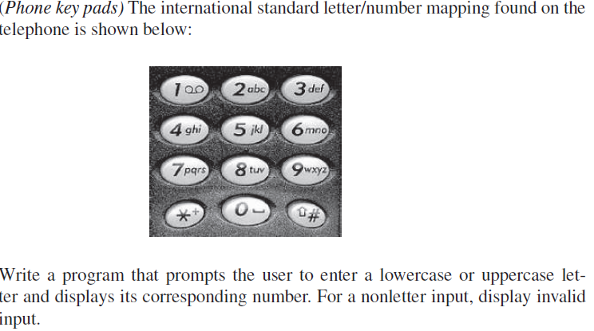
Exercise 3

Slide 7
import java.util.Scanner; public class LetterToNumber { public static void main(String[] args) { Scanner input = new Scanner(System.in); System.out.print("Enter a letter: "); String s = input.nextLine(); s = s.toUpperCase(); if (s.length() == 1 && Character.isLetter(s.charAt(0))) { char ch = s.charAt(0); int number = 0; | if (ch >= 'A' && ch <= 'C') number = 2; else if (ch >= 'D' && ch <= 'F') number = 3; else if (ch >= 'G' && ch <= 'I') number = 4; else if (ch >= 'J' && ch <= 'L') number = 5; else if (ch >= 'M' && ch <= 'O') number = 6; else if (ch >= 'P' && ch <= 'S') number = 7; else if (ch >= 'T' && ch <= 'V') number = 8; else if (ch >= 'W' && ch <= 'Z') number = 9; System.out.println("The corresponding number is " + number); } else { System.out.println("Invalid input."); } input.close(); } }

Slide 8
Exercise 4 – JAVA Methods
Write a Java method to count all vowels in a string. Here is sample run
Enter a string: Welcome to Java
Number of Vowels in the string: 6

Slide 9
import java.util.Scanner; public class VowelCounter { public static int countVowels(String str) { int count = 0; str = str.toLowerCase(); for (int i = 0; i < str.length(); i++) { char ch = str.charAt(i); if (ch == 'a' || ch == 'e' || ch == 'i' || ch == 'o' || ch == 'u') { count++; } } return count; } | public static void main(String[] args) { Scanner input = new Scanner(System.in); String userInput; int vowelCount; System.out.print("Enter a string: "); userInput = input.nextLine(); vowelCount = countVowels(userInput); System.out.println("Number of Vowels in the string: " + vowelCount); } }

Slide 10
Exercise-5 – Lottery program
First the program generates a random two-digit number, prompts the user to enter a two-digit number, and determines whether the user wins according to the following rule:
1. If the user input matches the lottery number in the exact order, the award is $10,000.
2. If all the digits in the user input match all the digits in the lottery number, the award is $3,000.
3. If one digit in the user input matches a digit in the lottery number, the award is $1,000.

Slide 11
